Slide 1
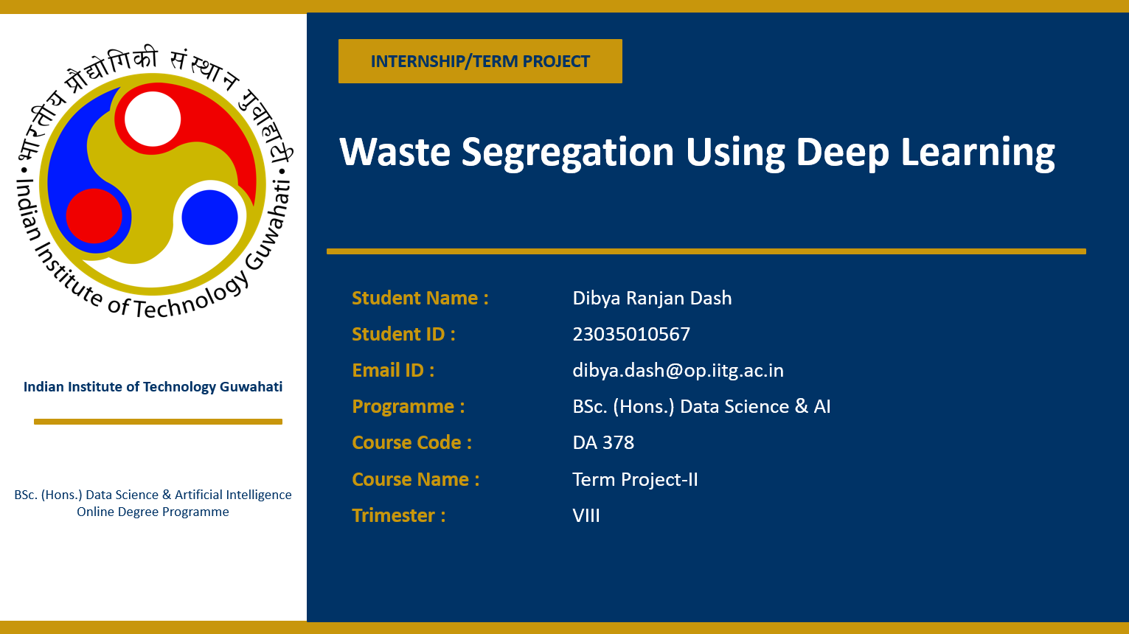

Slide 2
AGENDA
Introduction
Problem Context
Tools and Technologies Used
Dataset Used
Source Code
Outputs and Results
Evaluation Metrics
Summary

Slide 3
INTRoDUCTION
Waste management is a major challenge due to improper waste segregation and inefficient manual sorting. This project develops an AI-based garbage classification system using MobileNetV2 to classify waste images into multiple categories. The system provides confidence-based predictions and recycling advice, integrated with a Flask API and a Streamlit dashboard for real-time interaction. Overall, it highlights the potential of AI in improving efficient and sustainable waste management.

Slide 4
Problem Context
Improper waste segregation is a major issue affecting the environment and recycling efficiency
Manual sorting of waste is time-consuming and often inaccurate, especially at large scale
Waste images vary due to differences in quality, lighting conditions and background clutter
Certain categories (e.g., paper and cardboard) look very similar.
These factors make classification challenging and require the model to generalize well in real-world conditions

Slide 5
Tools and Technologies Used
Programming Language: Python
Deep Learning Framework: TensorFlow & Keras
Backend API: Flask
Dashboard: Streamlit
Image Processing: OpenCV, Pillow
Numerical Computation: NumPy
Visualization: Matplotlib

Slide 6
DataseT Used
Dataset was sourced from Kaggle and includes over 400 images per category, which were used for training the model.
Dataset used contains images of different types of waste. It includes categories like cardboard, glass, metal, organic, paper, plastic, and trash.
Images are resized to 224 × 224 pixels to match model input size.
Pixel values are normalized (scaled between 0 and 1) for stable training.
Data augmentation like rotation and flipping is applied to improve model performance.

Slide 7
Source Code
Training Script
Load the dataset and apply data augmentation techniques.
Train the model using categorical cross-entropy loss.
Flask API
Accept image input from user and process it.
Return predicted class with confidence score
Streamlit Dashboard
Provide an interactive user interface.
Allow users to upload images.
Display prediction results instantly.

Slide 8
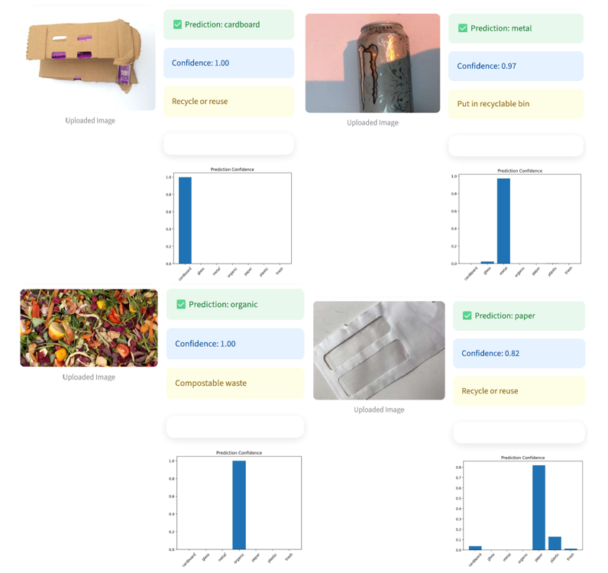
Outputs and Results

Slide 9
Evaluation Metrics
Accuracy → Measures how many predictions are correct
Prediction Confidence → Indicates how sure the model is about its prediction
The model performs well on distinct materials like glass, plastic, and organic waste.
However, there is some confusion between similar categories like paper and cardboard.

Slide 10
SUMMARY
This project demonstrates how AI can automate waste classification using deep learning, integrated with a backend API and dashboard for real-time predictions. The model performs better with balanced data and clear images, while data augmentation improves generalization despite challenges like noise and lighting variations.
Key Takeaway: Gained practical experience in deep learning, deployment, and solving real-world environmental challenges.
Future Work: Improve accuracy using advanced models like EfficientNet, increase dataset size, and deploy this as a real-world application.

Slide 11
THANK YOU
https://github.com/dibyardash/Waste-Segregation-using-Deep-Learning.git

